Slide 1
Battle of the Neighbourhoods
Capstone Project

Slide 2
Business Problem
Many factors influence siting a new business venture, including location.
Using cluster analysis on Foursquare location data identify 'goldilocks' neighbourhood to open a new venue.
Not untried or over-saturated.

Slide 3
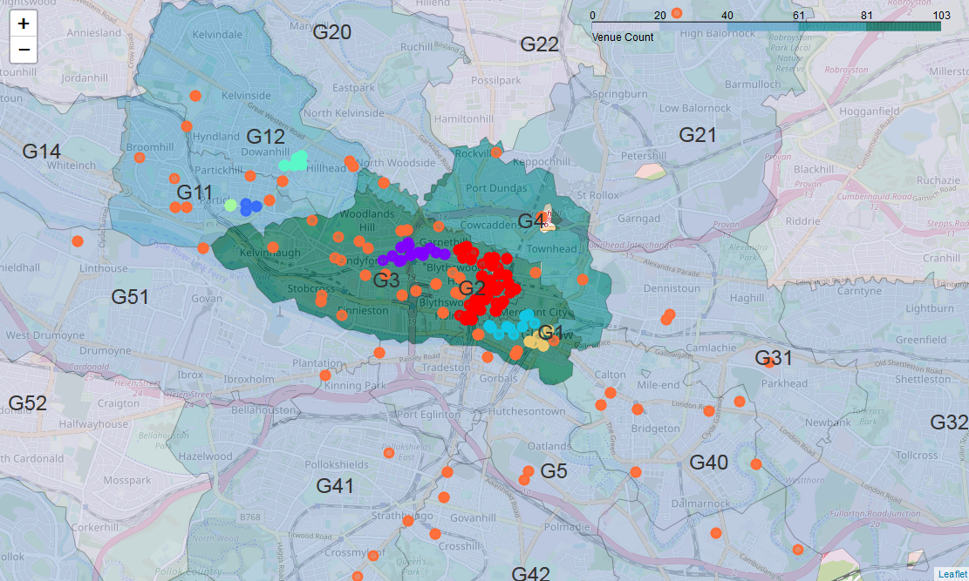
Cluster Analysis of Venues within Glasgow

Slide 4
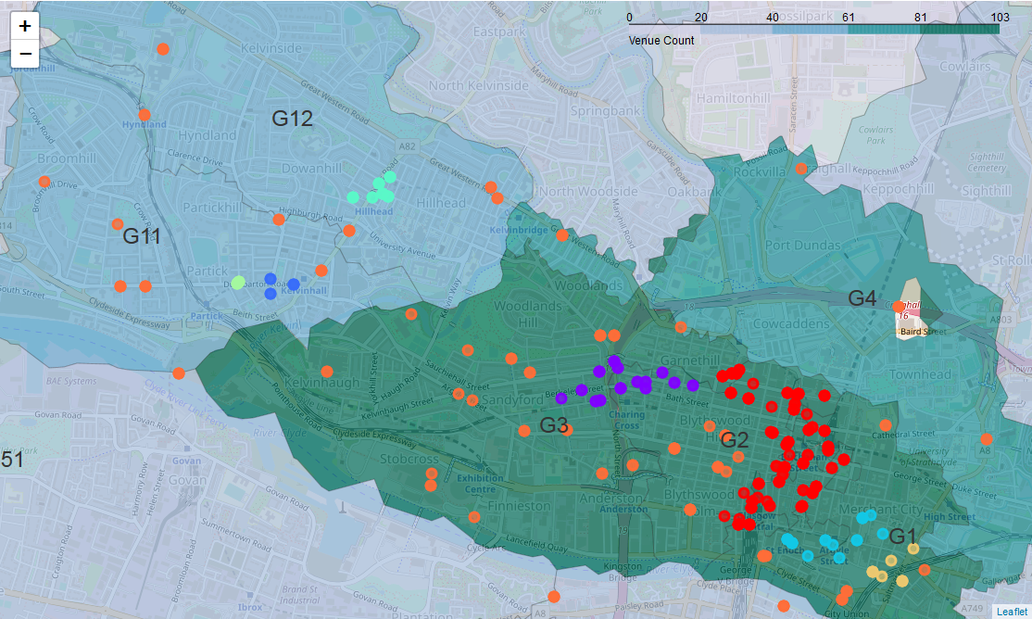
Detail of More Clustered Neighbourhoods

Slide 5
Where to Site a New Restaurant
G1, G2 and G3 neighbourhoods highly saturated
G13, G22, G23, G33, G34 and G52 neighbourhoods have no venues
Clusters in G1, G2, G3, G11 and G12
Therefore, site new venue in neighbourhood G11 or G12
Not untried
Not oversaturated
Of remaining neighbourhoods, already has some venue clustering, therefore a new business more likely to be viable

Slide 6
Further Analysis
Ensure all venues have actually been found
Postcode districts are quite large - postcode sectors may give deeper insight
Location is only one factor to look at when siting a new restaurant:
Parking availability
Visibility
Property prices
Etc…

